Slide 1
Low Lock Line Balance
Lear Tuscaloosa Plant 1
02/21/2023

Slide 3





Team Members Introduction
# | Team Members | Shift (A/B/C) | Department | Position / Job Responsibilities | Time at Lear | # Kaizen participated
1 | Aaron Rutledge | A | Engineering | Manager | 19yrs | 8
2 | Williams, Jerod | A | Engineering | IE | >1yr | 2
3 | Adam Hamm | A | Production | Ops Manager | 4yrs | 6
4 | Jonathon Underwood | A | Production | Team Lead | 14yrs | 7
5 | Scott Porter | A | Engineering | IE | >1yr | 2
Aaron
Jerod
Adam
Jonathon
Scott

Slide 4
Kaizen Background
Problem Definition (What Problem Am I trying to Solve?)
For the last 2 months, due to multiple factors as mix change, SAP launch delays, variation of volume, turnover and absenteeism, the HPCS has been over the Target of 5.25, reaching 6 hrs. by the end of January. Having a financial Impact of $291,000 USD and with a forecasted impact of another 300,000 USD by the end of march where the target is 5.35 HPCS.
Kaizen Goal(s) (including KPI to be improved)
Review MOST and identify opportunities of improvement over the production lines in order to absorb the variation on the HPCS and prevent the impacts.
KPIs
Overall Plant efficiency Increase by 1.25%
HPCS <= 5.35
Line balance <= 85%
Line efficiency => 90%

Slide 5
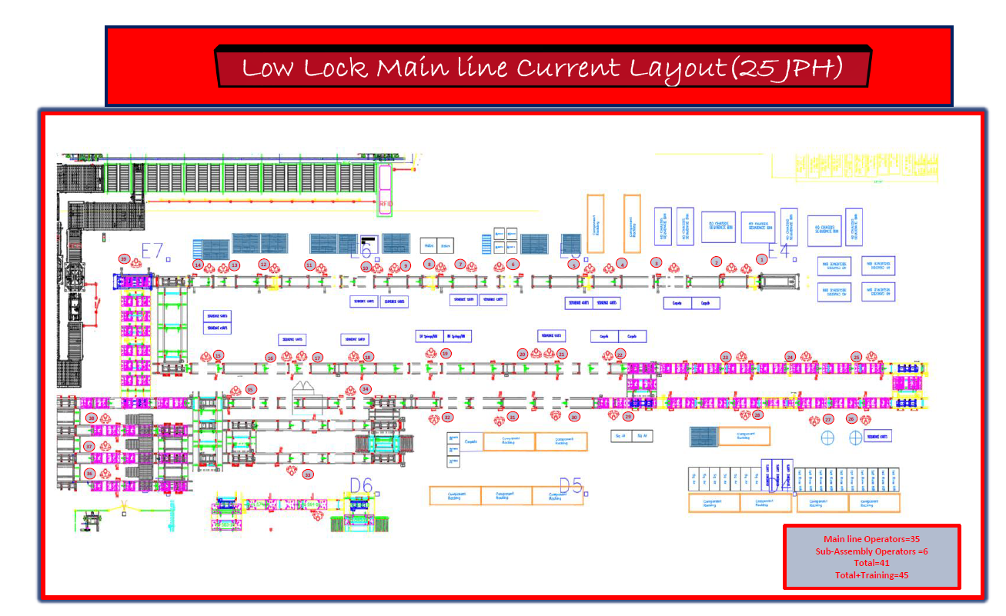

Slide 6
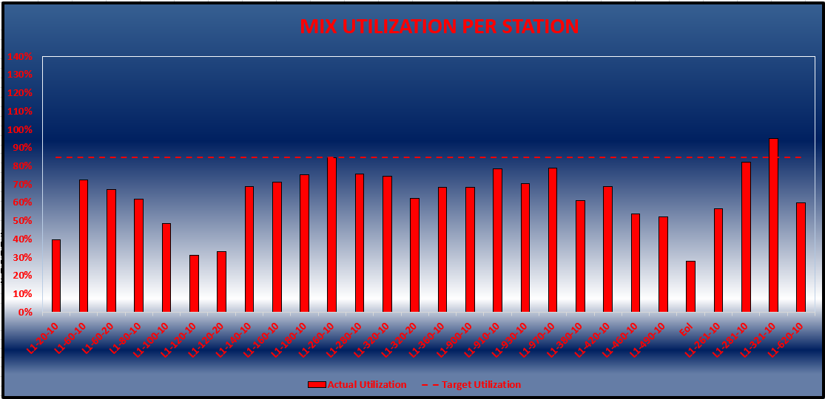
Projected
Collaborated Tasks

Slide 7
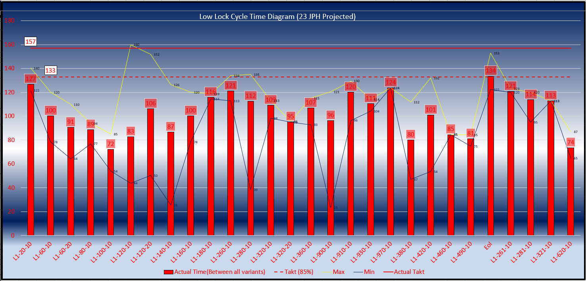
Projected
Collaborated Times

Slide 8
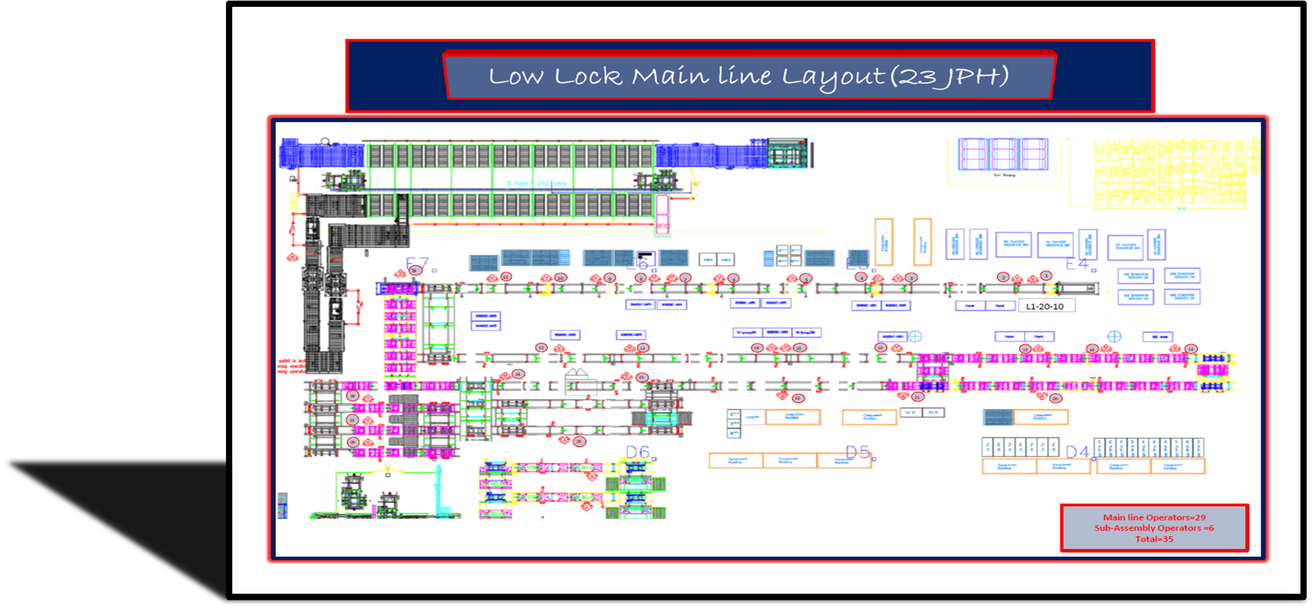
Support Functions During Implementation
Phase 1 Implementation
I.E: Jerod Williams
Manager: Aaron Rutledge
Maintenance: 1st Shift
Prod. Manager: Jonathon Underwood
Ops Manager: Adam Hamm
*Implemented during 15 min break (8:00-8:15 A.M)
*Total of 8 workstations reconfigured
*0% cost from reconfiguration
*Pre-implementation planning = 1 week

Slide 9
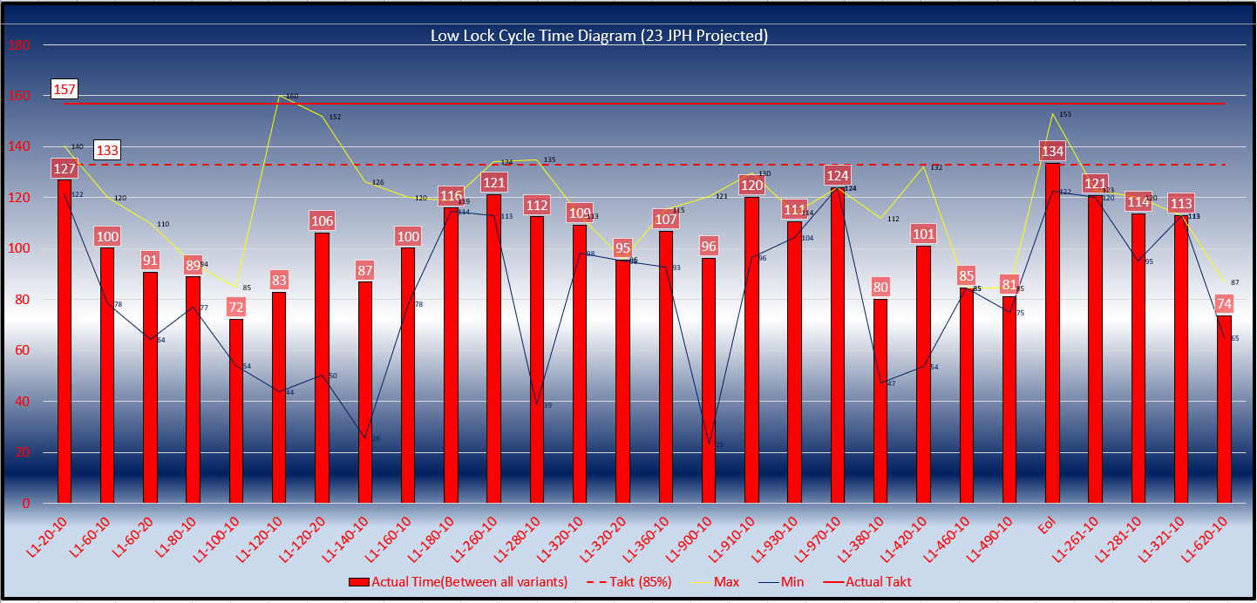
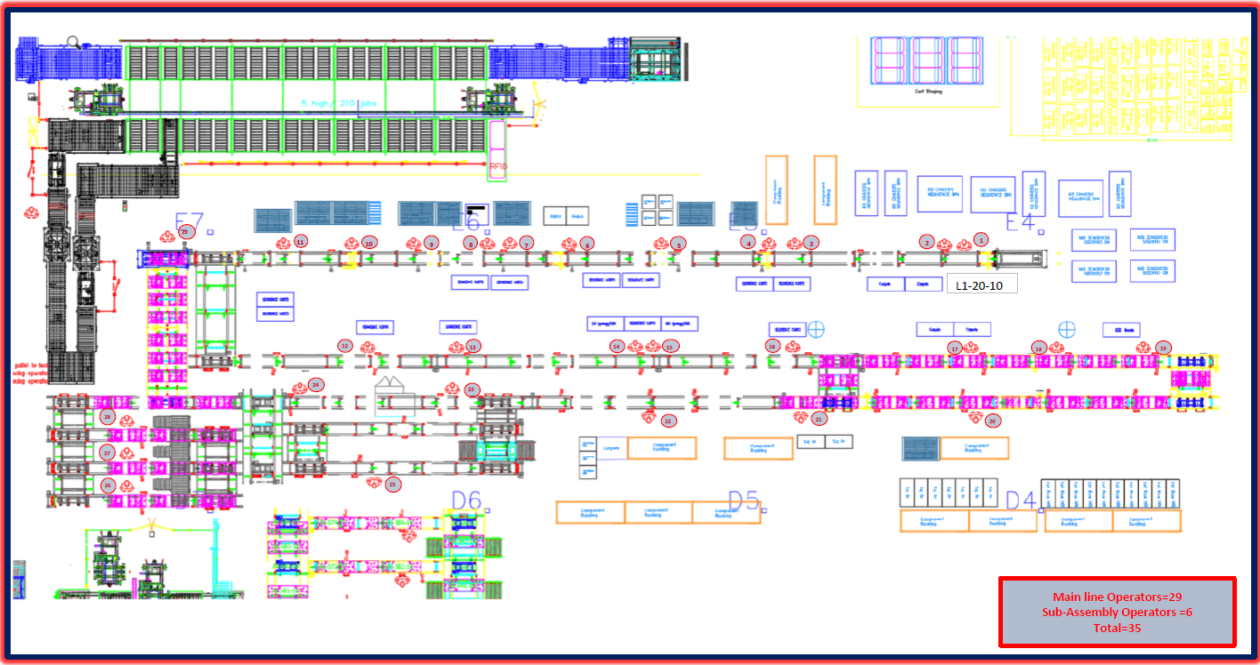
Workstation Content Break Down L1-020-10
1)Load Frames (60/40)
(2 Operators Required)
2)Scan
3)Input CCC Label
4)Input Traceability label
5)MKS Shaft Plastics
6) Power Up
Current steps remain the same
Additions In order (Transfer All Work Content from L1-040-10
Scan RH Build Label
Scan LH Build Label
Scan Rh Traceability Label
Scan Lh Traceability Label
Scan CCC Label
Power Seat Upward
LPS
Steps

Slide 10
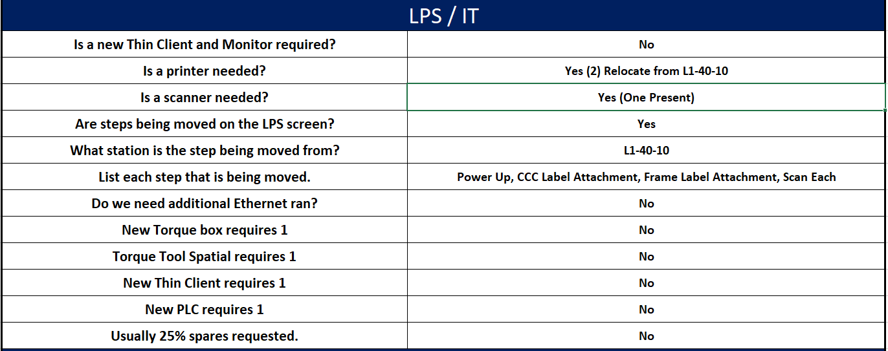
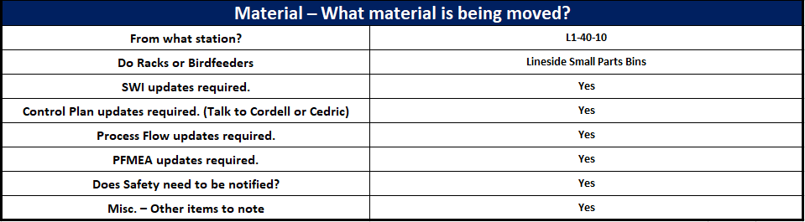
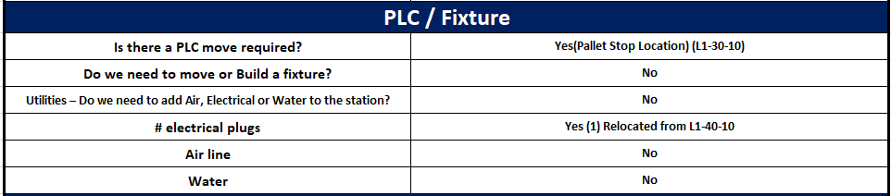
L1-020-10 Station Moves Overview
Workstation Move Requirements

Slide 11
1)Insert SAB Bracket
2)Insert/Torque 40% +20% Seatbelt
3)Attach Halo Plastic (LH/Ctr)
4)Attach RH-LH I/B side shield
5)EZE Button
Workstation Content Break Down L1-060-10/20
L1-060-10
Current steps remain the same
Additions In order
Scan RH EZE Entry
L1-60-20
Current steps remain the same
Additions In order
Scan LH EZE Entry
LPS
Steps

Slide 12
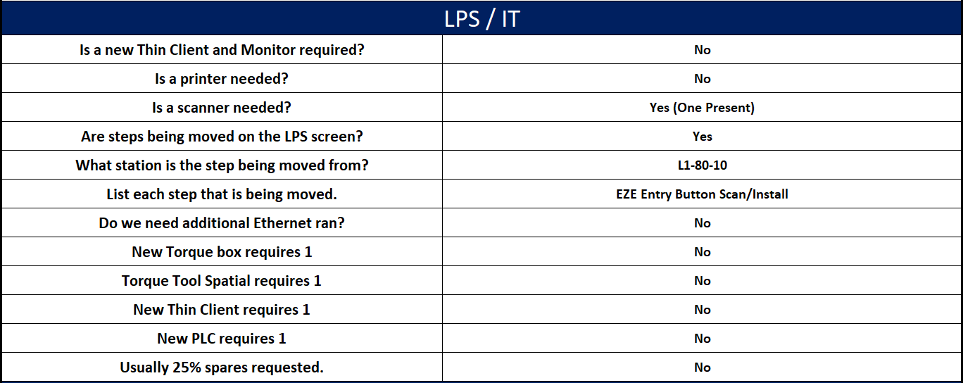
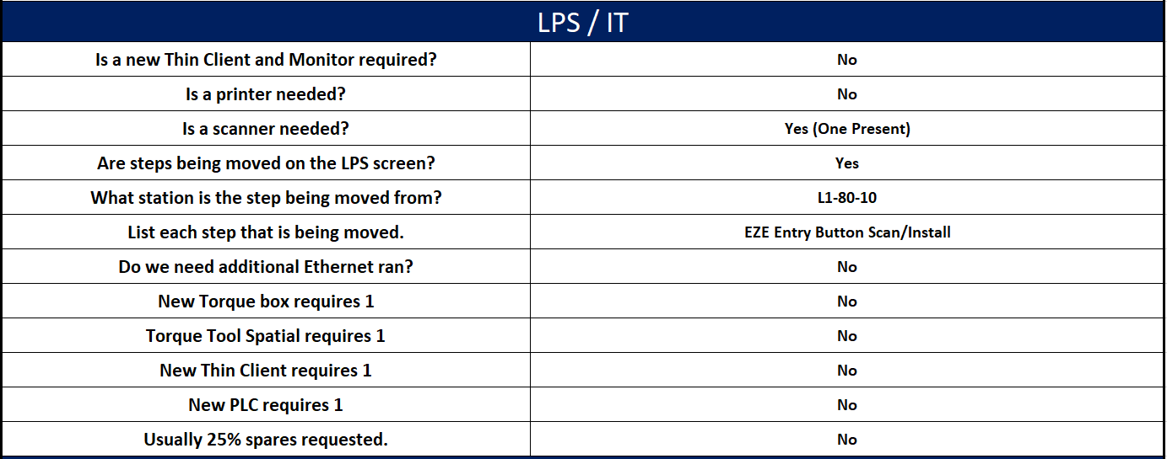
Workstation Move Requirements
L1-060-10
L1-060-20

Slide 13
1)Scan Rh + LH Wire Harness
2)Attach RH Back Wire harness to back frame
Workstation Content Break Down L1-080-10
1)Scan LH Wire Harness
2) Scan RH Wire harness
LPS
Steps

Slide 14
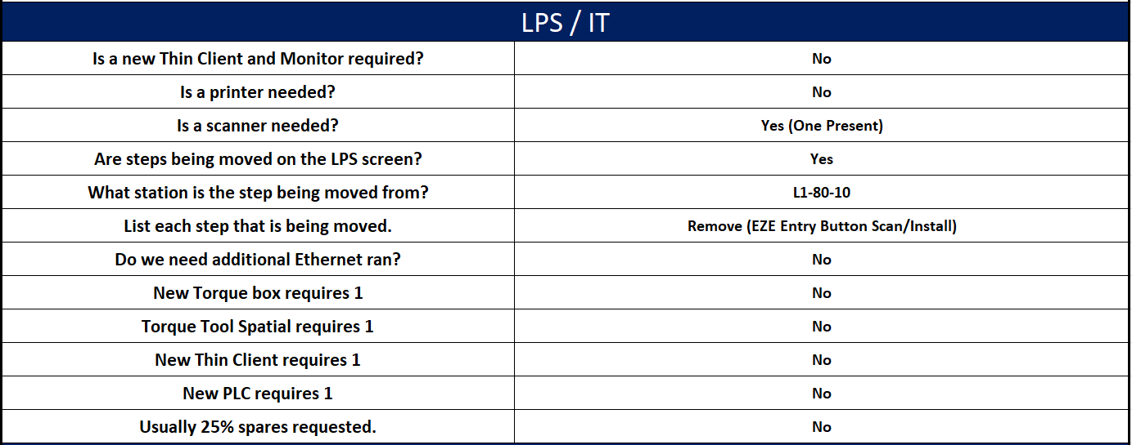
L1-080-10 Station Moves Overview
Workstation Move Requirements

Slide 15
1)Attach LH Back Wire harness to back frame
Workstation Content Break Down L1-100-10
Remove All Steps
LPS
Steps

Slide 16
1)Attach LH+RH Cushion Wire harness to Cushion frame
Workstation Content Break Down L1-120-10/20
All Steps Remain the Same
LPS
Steps

Slide 17
1)Scan/Wire harness (Validation)
2)Retractor Omega Install
3)Retractor Install/Torque
4)Halo Plastic Install
5)Bezel Support
6)Hand Start/Scan (RH SAB)
7)Attach Wire Harness
8)E-Strap Installation
Workstation Content Break Down L1-140-10
All Steps Remain the same
Additions in order
Scan RH SAB
Rivet RH Emergency E-Strap (3 Steps)
LPS
Steps

Slide 18
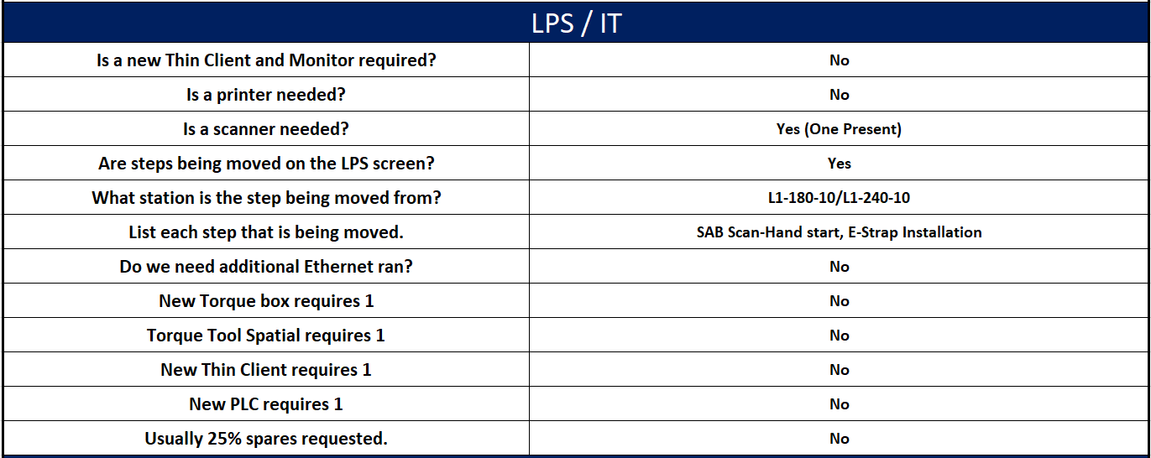
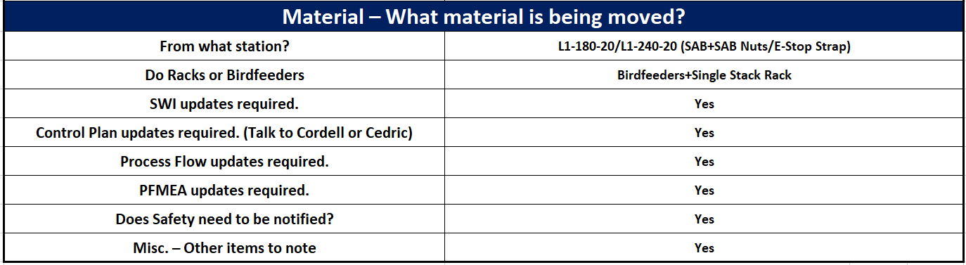
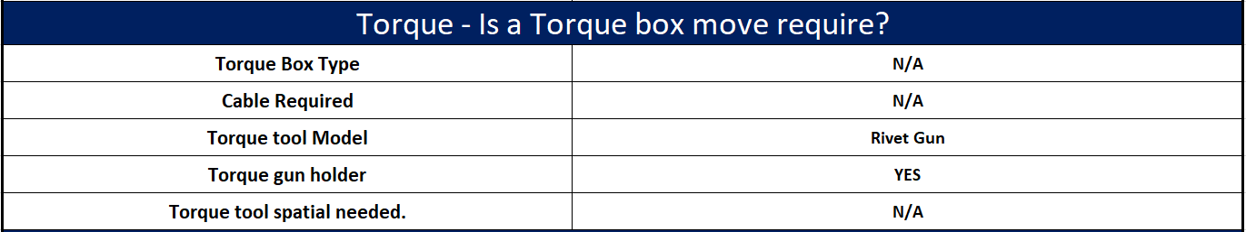
L1-140-10 Station Moves Overview
Workstation Move Requirements

Slide 19
1)Scan/Install Seatbelt (Ctr)
2)Center Side Shield Installation
3)Power 60/40 Seat Down
4)Hand Start/Scan (LH SAB)
5)Attach Wire Harness
6)E-Strap Installation
Workstation Content Break Down L1-160-10
All Steps Remain the same
Additions in order
Scan LH SAB
Rivet LH Emergency E-Strap (3 Steps)
LPS
Steps

Slide 20
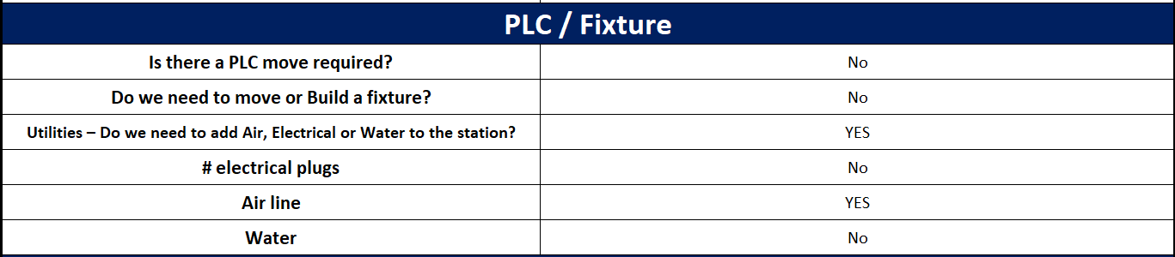
L1-160-10 Station Moves Overview
Workstation Move Requirements

Slide 21
1)Torque LH+RH SAB
2)Insert clips/attach MM Holder to frame (60/40)
Workstation Content Break Down L1-180-10
1)Top RH SAB Bolt
3) Bottom RH SAB Bolt
2) Top LH SAB Bolt
3) Bottom LH SAB Bolt
4) Visual Aid (Plastics Installment)
LPS
Steps

Slide 22
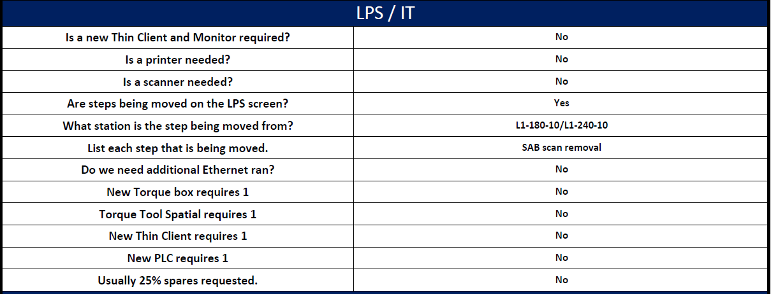
L1-180-10 Station Moves Overview
Workstation Move Requirements

Slide 23
Support Functions During Implementation
Phase 2 Implementation
I.E: Jerod Williams
Manager: Aaron Rutledge
Maintenance: 3rd^{t} Shift
*Implemented during 4 hour window (Sunday)
*Total of 11 workstations reconfigured
*0% cost from reconfiguration
*Pre-implementation planning = 1 week after phase 1

Slide 24
1)Scan
2)Insert LH+RH Back Assembly to Frame
3)Massage Connect
Workstation Content Break Down L1-260-10
No Modifications To Workstation
LPS
Steps
Tuscaloosa

Slide 25
1)Insert/Torque Retractor Bolt
2)Insert 20% Back Assembly to Frame
3)Screws to mm holder
Workstation Content Break Down L1-280-10
Current Steps Remain the Same
Additions in order
Fasten LH MM Holder (6Steps)
Fasten RH MM Holder
(6 Steps)
Camera tag LH
Camera tag RH
LPS
Steps

Slide 26
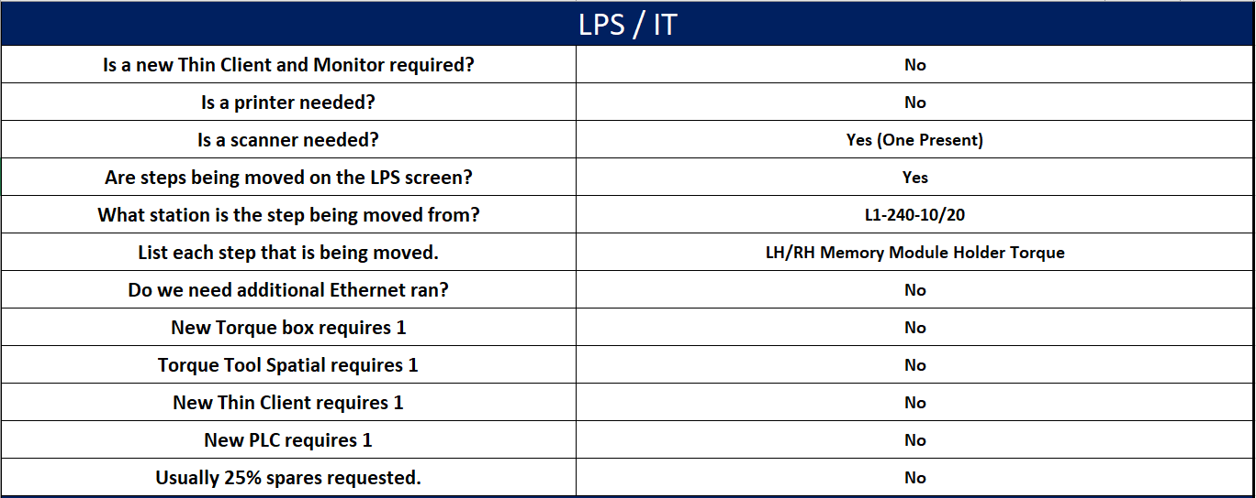
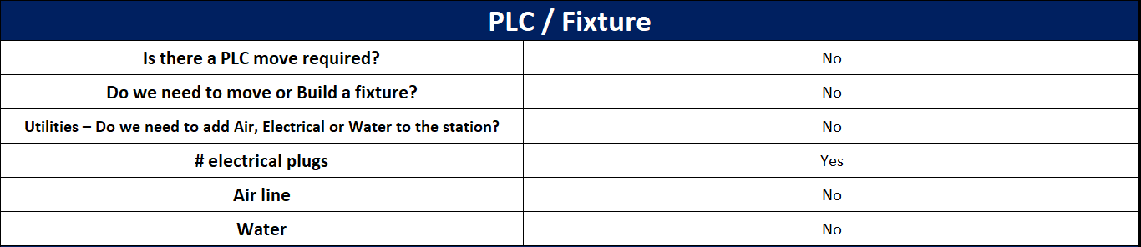
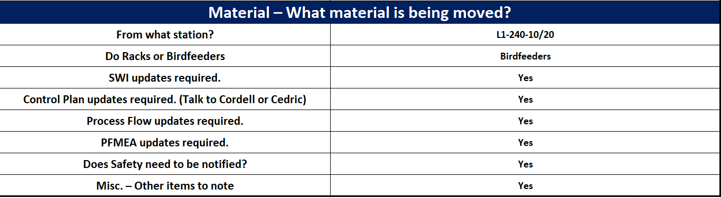
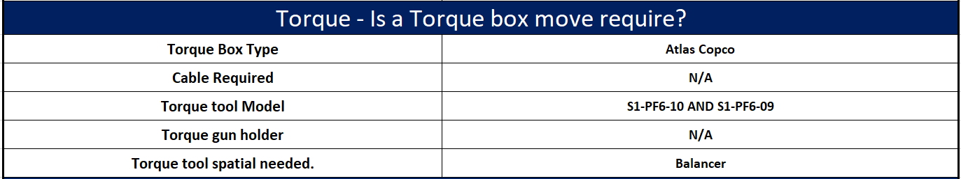
L1-280-10 Station Moves Overview
Workstation Move Requirements

Slide 27
1)Scan/Insert 60% cushion assembly to frame
2)Scan/Insert 40/% cushion assembly to frame
3)Spring Installation
4)MM Installation
Workstation Content Break Down L1-320-10/20
L1-320-10
1)LH Memory Module Scan
2) Spring Installation
3) LH RSC Trim Scan
4) LH RSC Heater Pad Scan
L1-320-10
1)RH Memory Module Scan
2) Spring Installation
3) RH RSC Trim Scan
4) RH RSC Heater Pad Scan
LPS
Steps

Slide 28
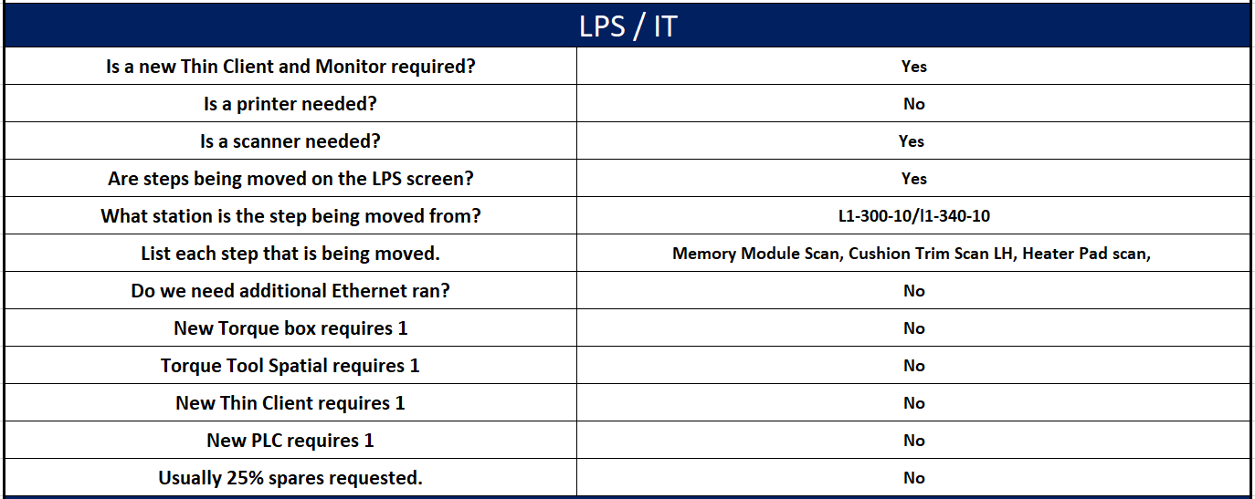
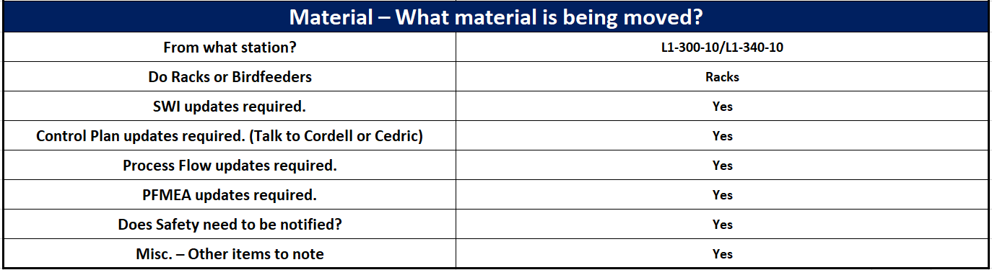
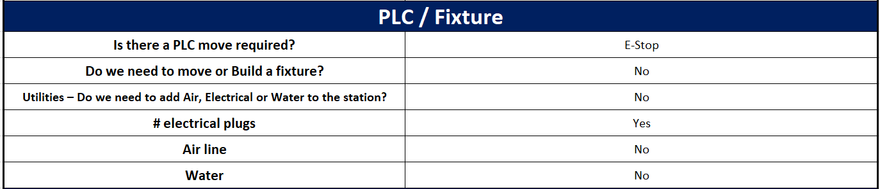
L1-320-10/20 Station Moves Overview
Workstation Move Requirements

Slide 29
1)Power seat down
2)Install HR Guides
3)Install Headrest
Workstation Content Break Down L1-360-10
1) Lower LH Seat Back
2) Lower RH Seat Back
3) Transfer all steps from L1-950-10 (Headrest Installation)
LPS
Steps

Slide 30
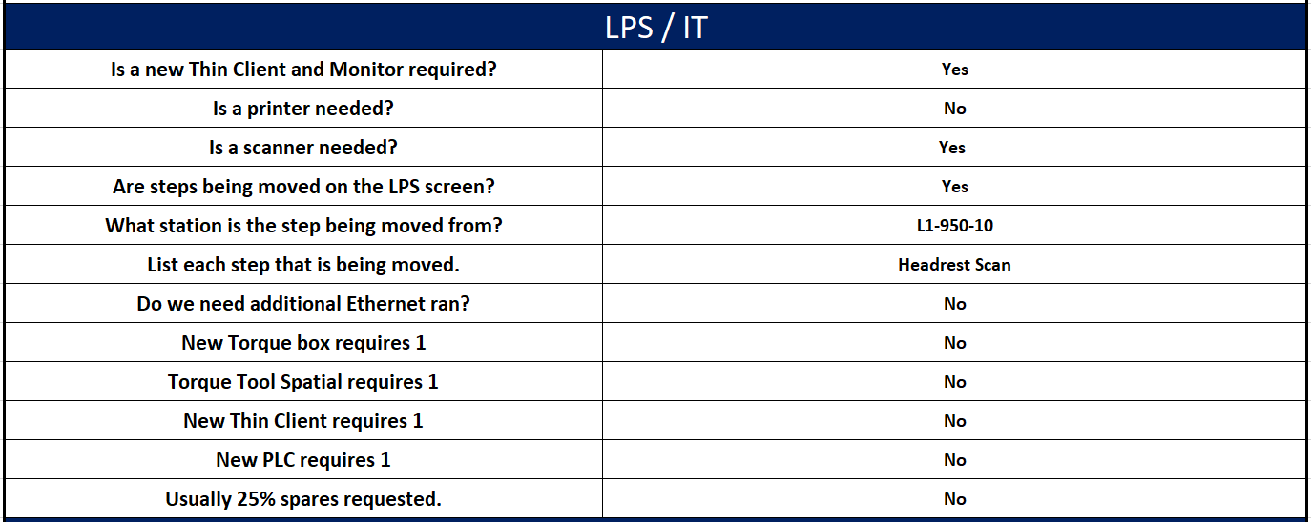
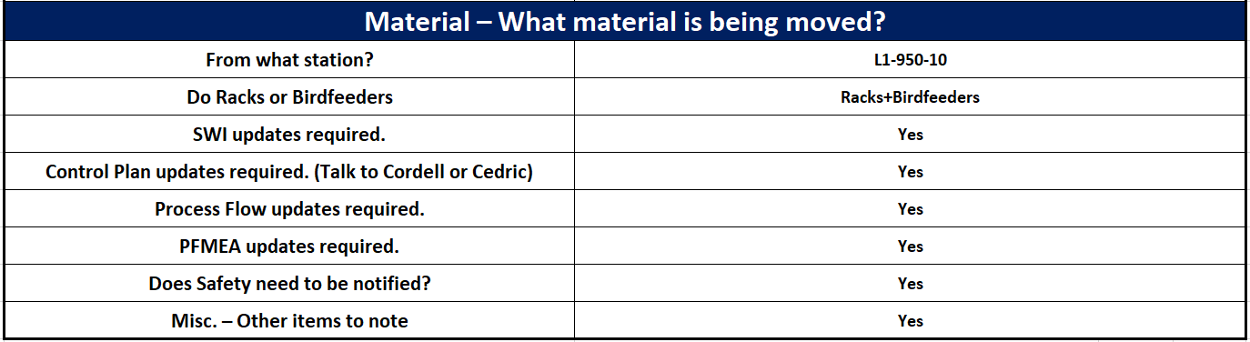
L1-360-10 Station Moves Overview
Workstation Move Requirements

Slide 31
1)Scan/Install Carpets
2)Closeout 20% LH back assembly
Workstation Content Break Down L1-900-10
1) Scan 20% Carpet
2) Scan LH Carpet
3) Scan RH Carpet
4)Close-out 20% Back
LPS
Steps

Slide 32
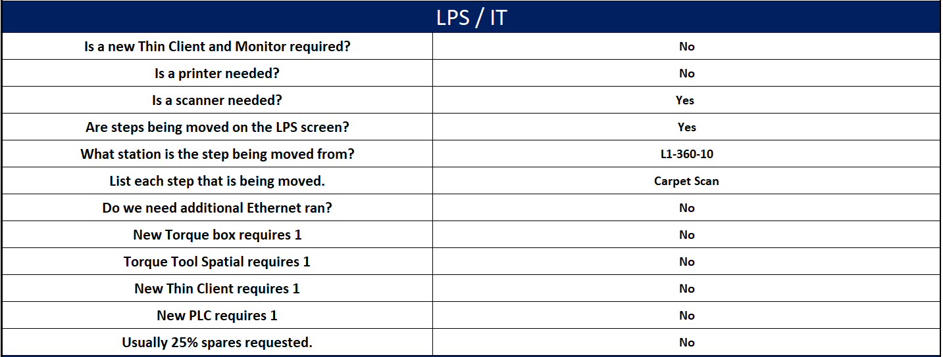
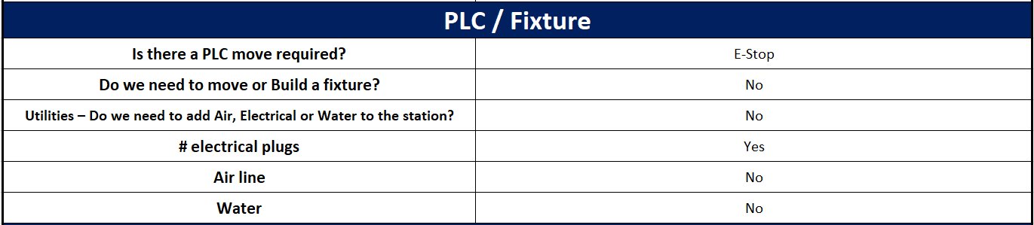
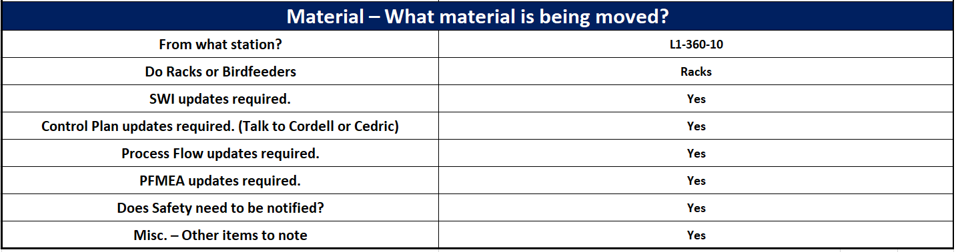
L1-900-10 Station Moves Overview
Workstation Move Requirements

Slide 33
1) Closeout 40% LH back assembly
2) Install 40% Retractor Bezel
Workstation Content Break Down L1-910-10
1)Close-Out LH Back
2)Fasten LH Bezel
LPS
Steps

Slide 34
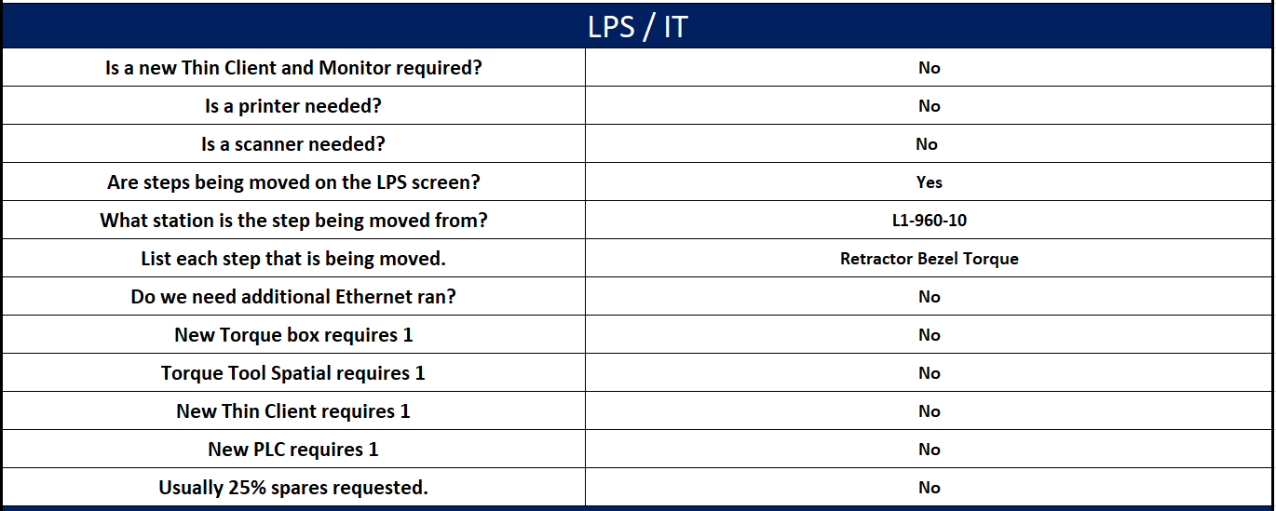
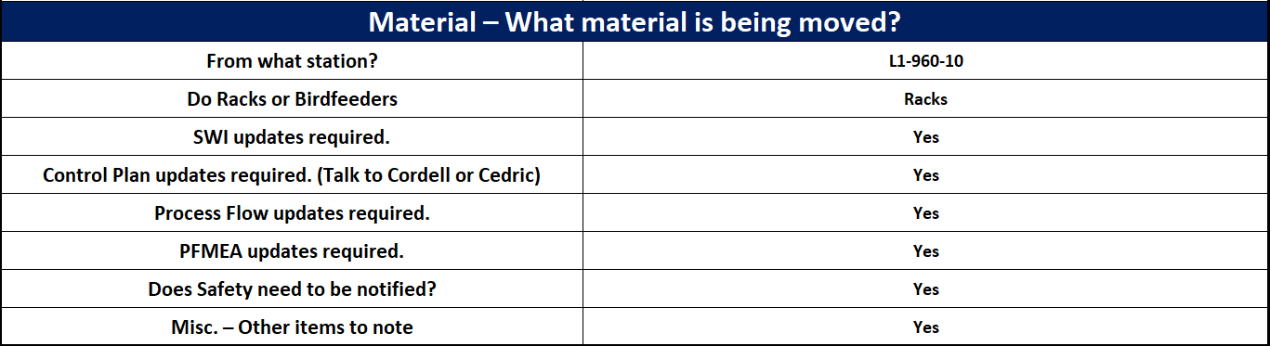
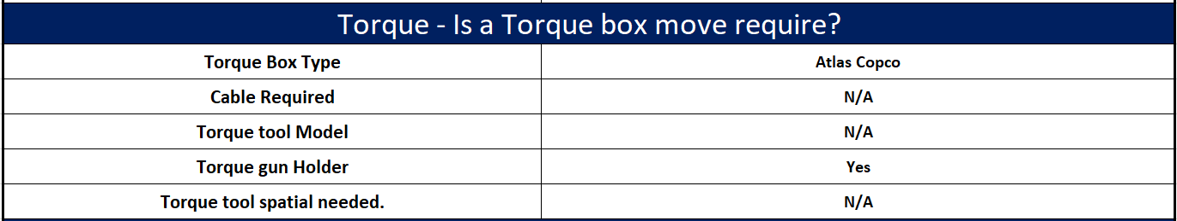
L1-910-10 Station Moves Overview
Workstation Move Requirements

Slide 35
1) Closeout 40% RH back assembly
2) Install EZE Bezel
Workstation Content Break Down L1-930-10
1)Close-Out RH Back
LPS
Steps
Tuscaloosa

Slide 36
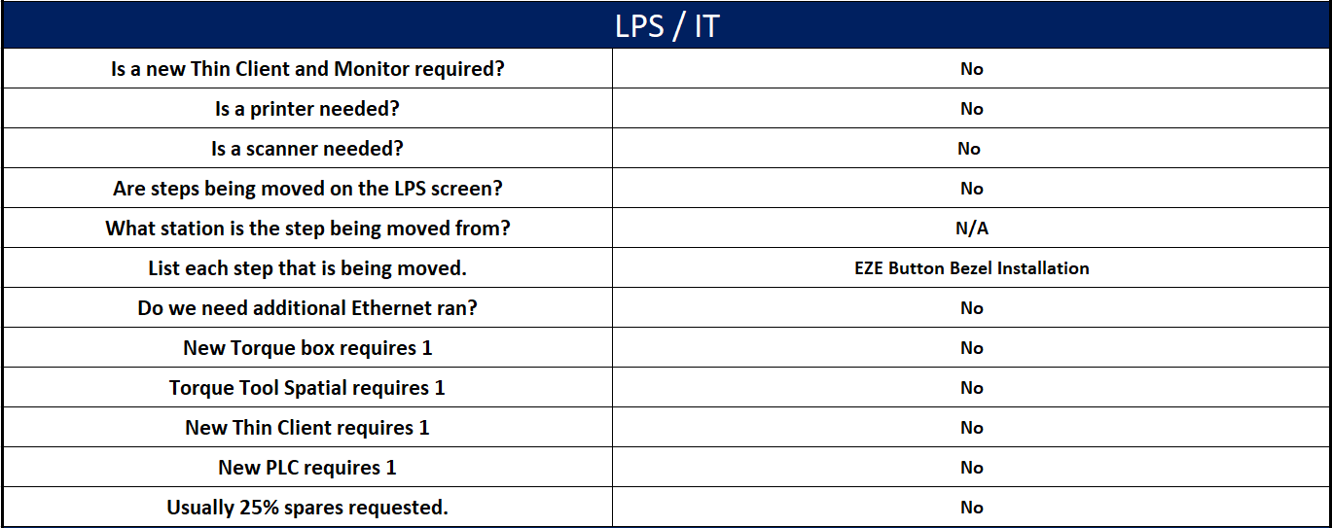
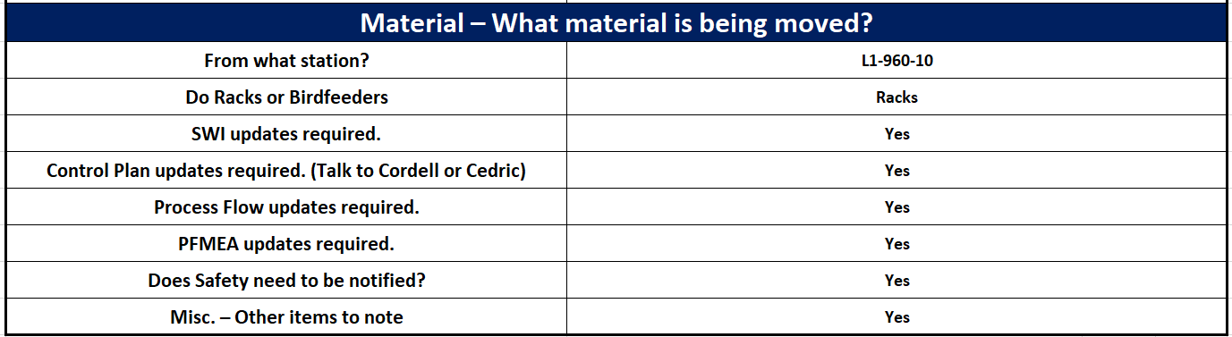
L1-930-10 Station Moves Overview
Workstation Move Requirements

Slide 37
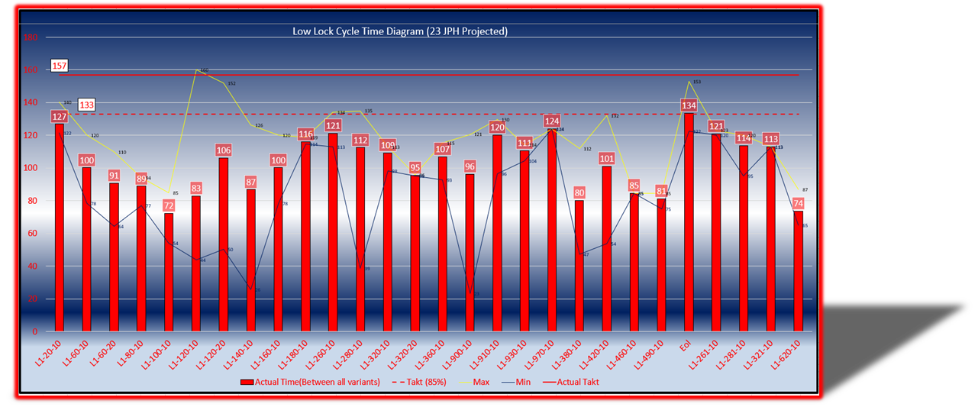
1) Power LH/RH upward
2) Attach Connectors
3) Install Plastics
4) Attach Plastics with rivet
Workstation Content Break Down L1-970-10
1)Power LH back Upward
2)Power RH back Upward
LPS
Steps

Slide 38
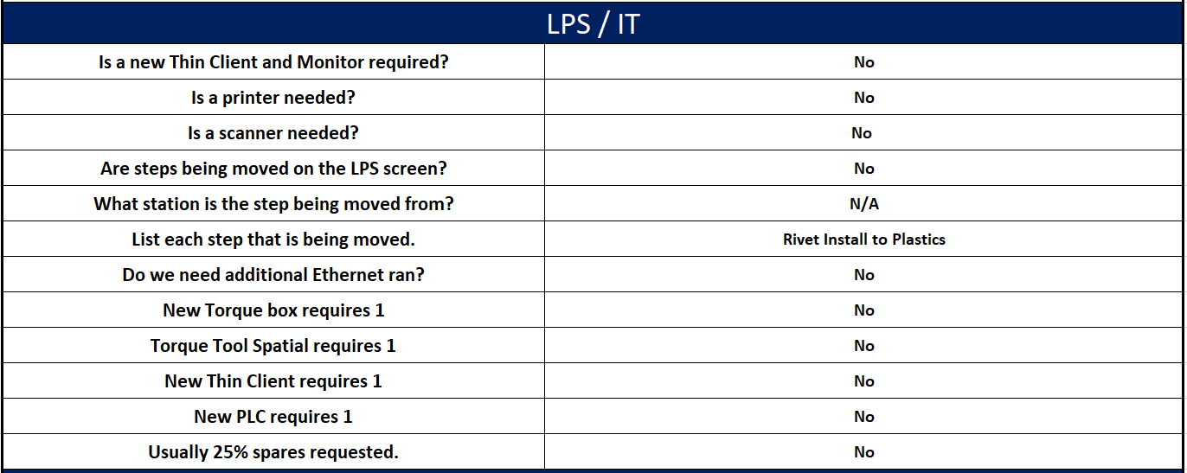
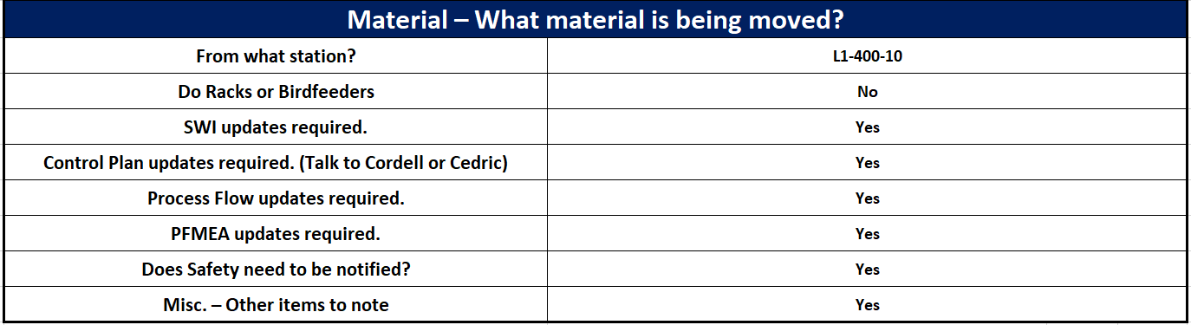
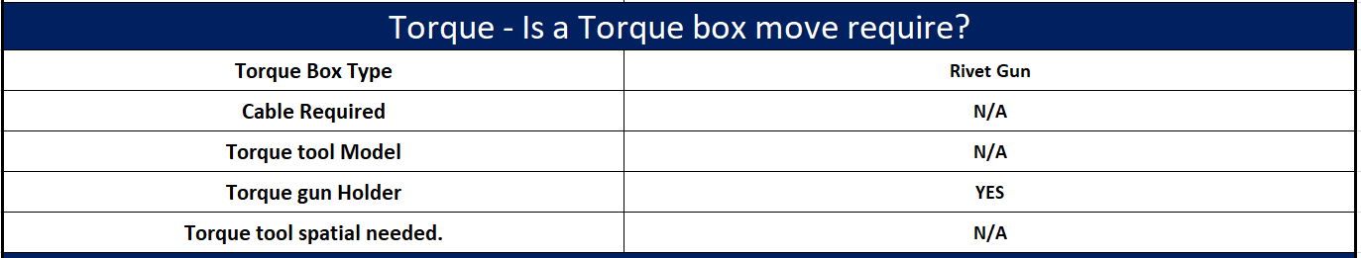
L1-970-10 Station Moves Overview
Workstation Move Requirements

Slide 39
1)Scan/Install
Armrest
2)Install Plastics
Workstation Content Break Down L1-380-10
No Changes to Workstation
LPS
Steps

Slide 40
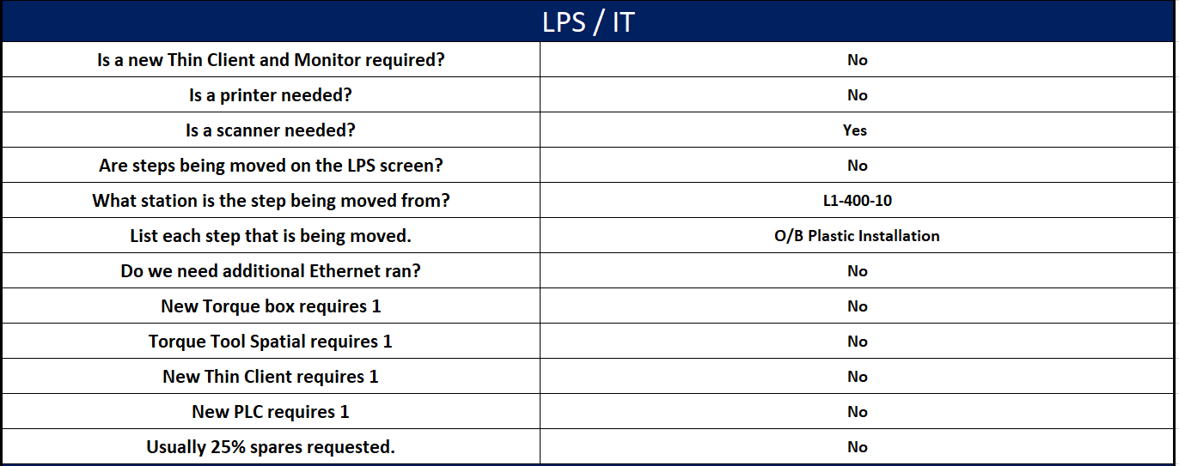
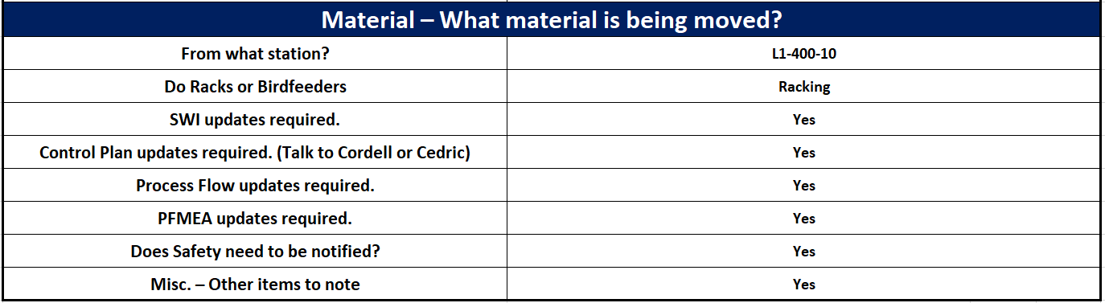
L1-380-10 Station Moves Overview
Workstation Move Requirements

Slide 41
1)Install AR Plastics
2)Install Latch Cover
3)Install Railing
4)Install Toe Kick
Workstation Content Break Down L1-420-10
Current Steps Remain the Same
Additions in order
Scan RH Polster Bar
Scan LH Polster Bar
Scan LH Kick Carpet
Scan RH Kick Carpet
LPS
Steps

Slide 42
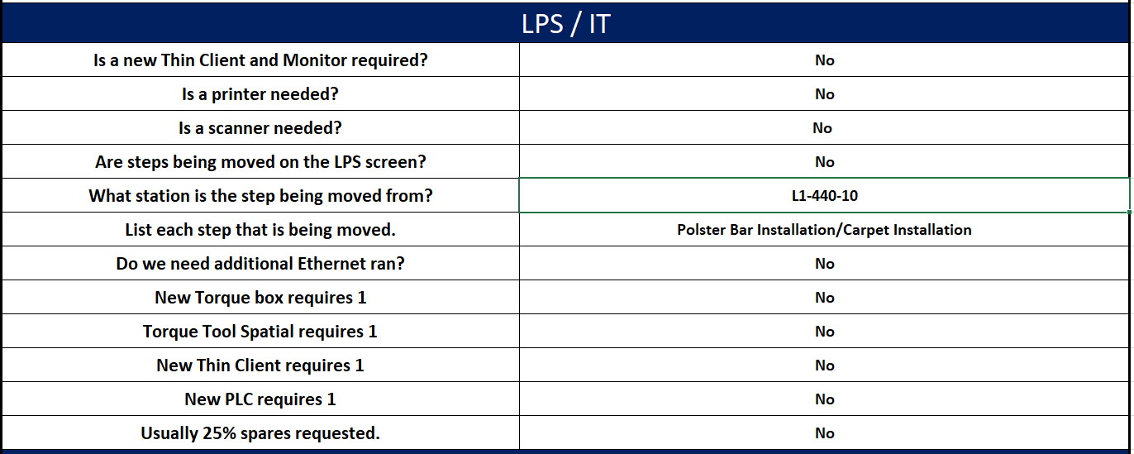
L1-420-10 Station Moves Overview
Workstation Move Requirements

Slide 43
Timing
Pending actions to improve line performance
New Pallets prototype April 2023
PAR Approval May 2023
New pallets acquisition June 2023

Slide 45
Business Impact
KPIs (before & after)
 | KPI | Kaizen |  | After | Notes / Comments
 |  | Feb | Mar | Apr
1.- | Cycle time | 157 | 134 | 128 | 15% Improvement
2.- | Headcount | 41 | 35 | 35
3.- | Low Lock Line Balance | 76% | 92% | 92% | Over a 85% Optimization
4.- | HPCS | 6/5.25 | 5.32/5.25 | 5.43/5.55
Improvement Calculations (Must list OIP number with OIP section for hard savings)
 | Results | $ USD | OIP # / Section
HC Reduction | Hard/Savings | $622,080/yr | 193988 / Sect. 2
HPCS Under

Slide 46
Kaizen Evaluation
8.90

Slide 47
End
Thank you

